Slide 1

NETWORK SERVICES

Slide 3
TOPICS TO BE COVERED
DHCP
Proxy Services
DNS
Directory Services
Mail Services

Slide 4
DHCP

Slide 5
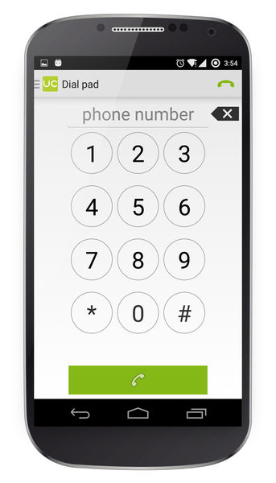

Phone Numbers
IP Address Allocation is somewhat relatable.
HOW ?
When a customer signs up for service, mobile phone companies assign a number from a pool of available numbers. Generally, these numbers are assigned at random, though sometimes a helpful employee may offer a choice of numbers to the customer. The available numbers are drawn from the blocks of numbers assigned through Bellcore/Telcordia and NANPA and consist of numbers not currently in use or which have not been used within the preceding 90 days.

Slide 6
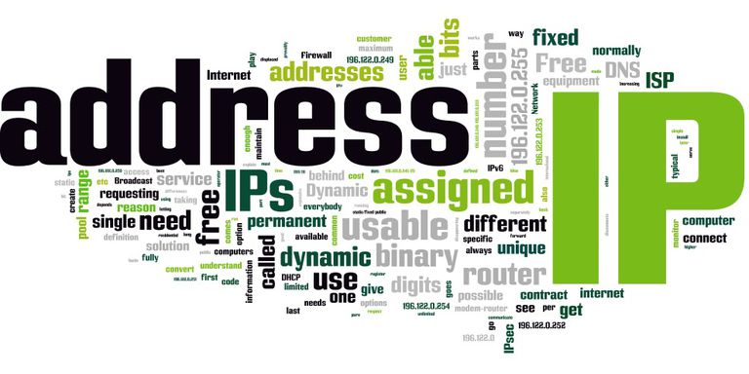
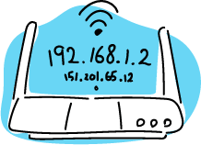
IP Address
Logical Addresses for network nodes (PC, switch, routers, etc.) to identify them uniquely in the network.

Slide 7
Types :
DYNAMIC :
Temporary Addresses
These IP addresses are assigned to a computer when they get connected to the Internet each time.
Actually borrowed from a pool of IP addresses, shared over various computers.
Static
IP
Dynamic
IP
Since limited number of static IP addresses are available, ISPs usually reserve the portion of their assigned addresses for sharing among their subscribers in this way.
STATIC :
Kind of Permanent Addresses
(change by Network Administration)
Static IP addresses are considered as less secure than dynamic IP addresses because they are easier to track.

Slide 8
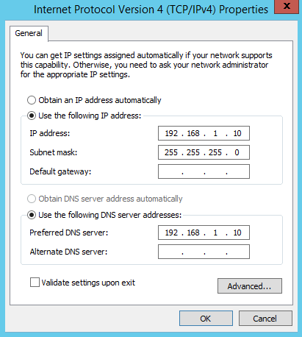
Address Allocation : MANUAL

Slide 9
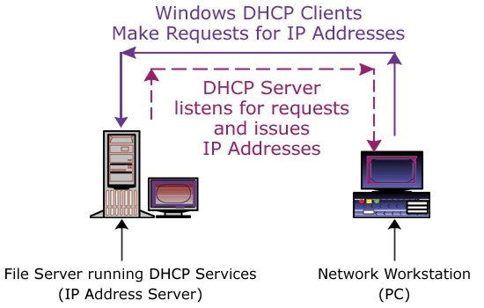
Address Allocation : DYNAMIC (DHCP Protocol)
Dynamic
Host
Configuration
Protocol

Slide 10
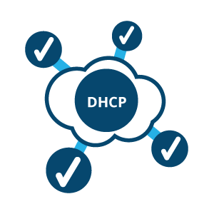
DHCP
Used to automatically deliver IP addressing.
Reduces the amount of time you spend configuring computers on our network
Used by default (now) unless you specify otherwise.
The ipconfig /all command will indicate whether the configuration came from a DHCP server computer.
Technical name – RFC2131

Slide 11
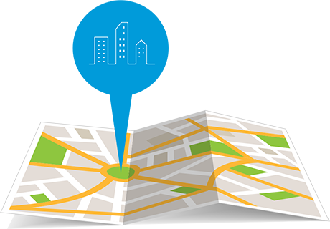
DHCP Address Allocation Methods
Dynamic Allocation
Given IP address is revocable.
IP address is given from a Pool (range of IP addresses) at the server, on a LEASE methodology.
Automatic Allocation
Same method as Dynamic Allocation
Given IP address is never revoked.
Manual Allocation
The address is allocated based on user’s request.
The address could be out of the DHCP allocated pool.
Also Permanent as Automatic Allocation

Slide 12
Technologies prior to DHCP
BOOTP
RARP
ARP
ARP (RFC826)
Address Resolution Protocol
Maps known IP address to
unknown MAC address
RARP (RFC903)
Reverse ARP
Early protocol for dynamic IP address assignment
Very limited – does not support assigning name servers and default gateway.
BOOTP (BOOTstrap Protocol)
Defined to overcome the limitations of RARP.

Slide 13
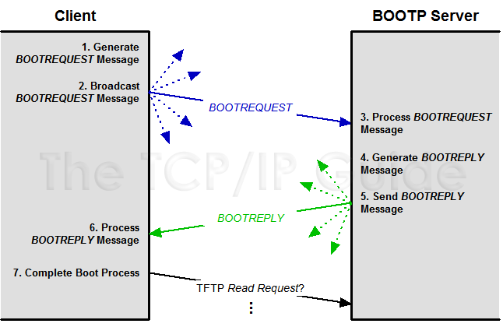
BOOTP
Client Creates Request
Client Sends Request
Server Receives Request and Processes it
Server Creates Reply
Server Sends Reply
Client Processes Reply
Client Completes Boot Process

Slide 14
Then why DHCP ?
DHCP is an extension to BOOTP, defined to fix the limitations of BOOTP :
IP Address lease (time)
BOOTP assigns IP addresses without a lease time.
In order to free an IP address assigned by BOOTP, a host needs to be rebooted.
In DHCP, an IP address is assigned to a client only for a limited (but extensible) time. If the IP address is not renewed it goes back to the pool of free IP Addresses.
Vendor Options

Slide 15
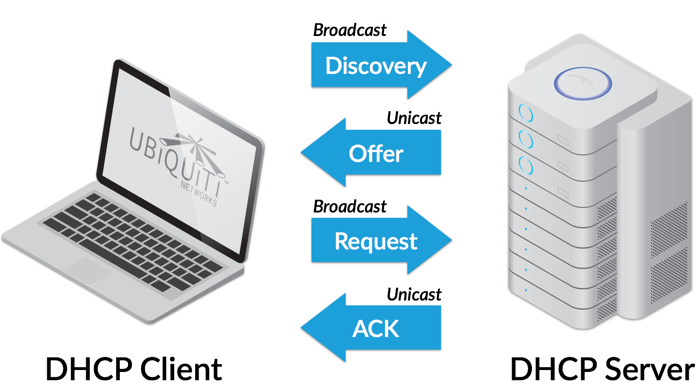
Leasing an IP Address
DORA
An IP Address is leased during the boot process.
The overall process is composed of 4 broadcast packets :
DHCPDISCOVER (1)
DHCPOFFER (2)
DHCPREQUEST (3)
DHCPACK (5)

Slide 16
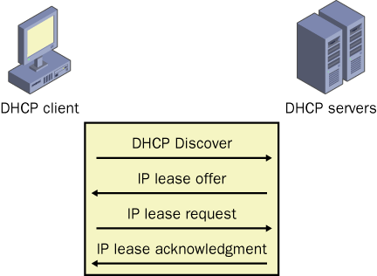
Leasing an IP Address
Any DHCP server that receives the DISCOVER packet responds with an OFFER packet.
The DHCP client responds to the OFFER packet it receives with a REQUEST packet
An ACK (acknowledgement) packet indicates confirmation that the client can use the lease.
Once the ACK is received, the client can start using the IP address and options in the lease.

Slide 17
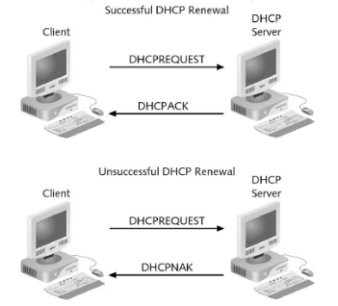
Renewing an IP Address
The IP address can either be permanent or timed (based on allocation method deployed).
A permanent address is never used for another client.
Timed lease expire after a certain time.
Windows clients attempt to renew their lease after 50% of the lease time has expired.
A DHCP server may honor or reject a renew request.

Slide 18
Some extra bits
Backward compatible with BOOTP : static configuration
Uses client-server model.
PORTS :
67 – connections to server
68 – connections to client
DHCP was created by Dynamic Host Configuration Working Group of the Internet Engineering Task Force (IETF).
Runs over UDP.
Can you guess why? : DHCP server uses 2 Databases

Slide 19

Topic End

Slide 20
DOMAIN NAME
DOMAIN NAME
SYSTEM

Slide 21


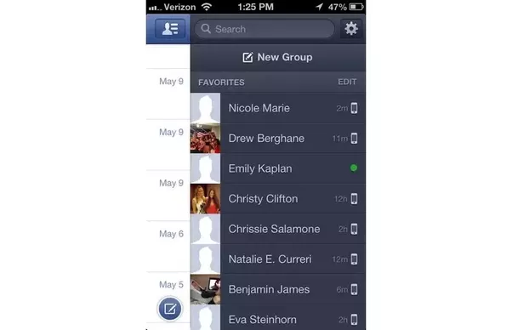
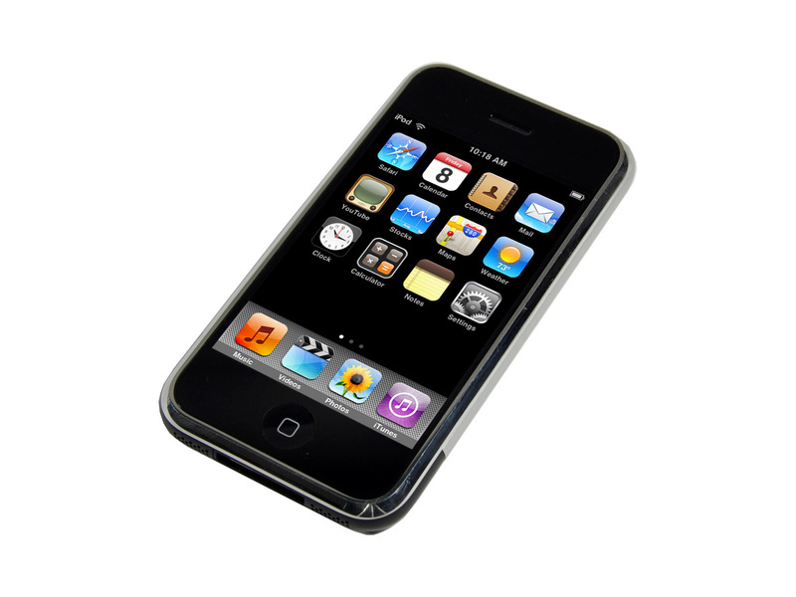
WHY??

Slide 22
What is DNS?
Domain naming system is the Hierarchical naming system for domain services, or any resource connected with internet or private network.
This system used on the internet for converting domain names to their corresponding IP address.
Capgemini
ATP
STP
DTP
F1
F2
F3
F8
T1
T2
T3
LAB PC 1

Slide 23
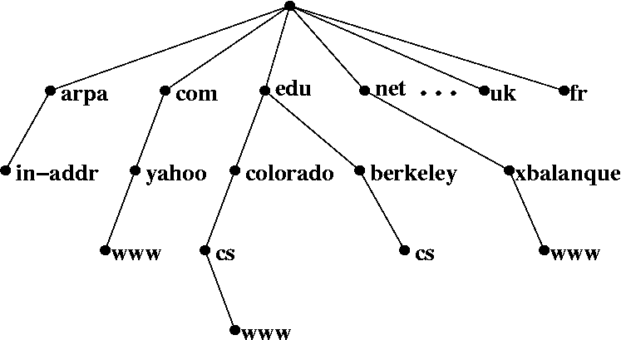
DNS HIERARCHY
Organizational
Reverse
ROOT
Geographical

Slide 24
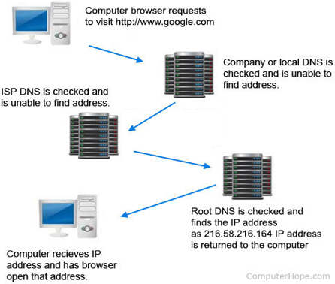
How DNS works?

Slide 25
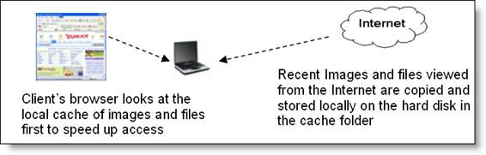
DNS Client side Caching
DNS Tools:
Whois
nslookup
DNS Records:
A record
CNAME record
SOA record
DNS Features:
Scalability
Consistency
Reliability

Slide 26
Topic End

Slide 27
EMAIL SERVICES

Slide 28
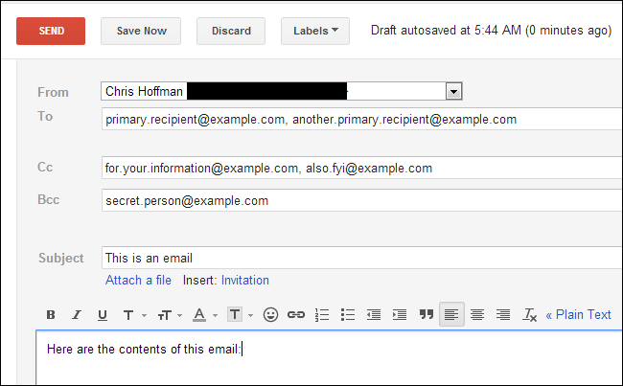
Email Structure
From : YOU
To : (blank)
Cc : All important stakeholders
Bcc : Whole list of Invitees (to whom invitations are to be sent)

Slide 29
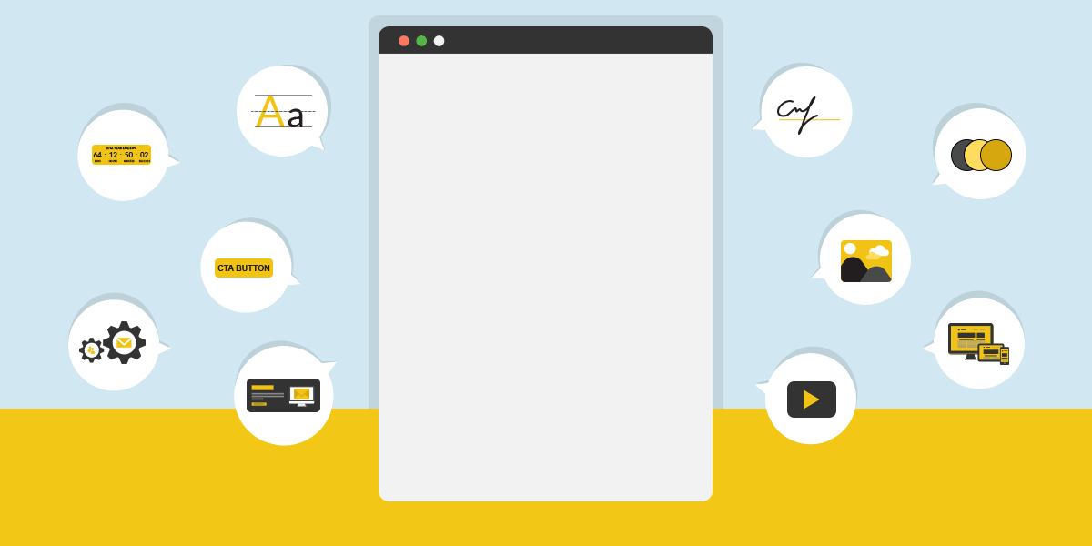
The Past, Present and Future of Emails

Slide 30

1980s
‘82 – EMAIL word
‘82 – SMTP
‘88 – Ist Commercial, Microsoft Mail MMM
1970s
‘71 – Ray Tomlinson
Ist N/w MAIL
ARPANET
‘77 – Standard Format
‘77 – US Postal Service
THREAT TO MAIL
1960s
‘65 - Email is introduced at MIT
‘89 – CompuServe
‘89 – IBM Lotus Notes 1.0

Slide 31
Early 1990s
Early 90s – Email spam
’92 – MS Outlook for MS-DOS
Late 1990s
‘97 – MS Outlook 97 (Central Hub that includes email, scheduling, contact mgmt, task mgmt & a journal module.
2000s
2000 – MS introduces Entourage mail for Mac.
2003 – MS Outlook 2003 introduces junk mail and phishing filters & multiple user accounts.
‘93 – AOL & Delphi connect their proprietary email systems to the Internet
‘93 – BellSouth & IBM : Simon Personal Communicator (World’s first mobile phone with PDA features, including email capability)
‘98 – MS Outlook 2000 (ability to customize & incorporate personal, corporate & Web based info in 1 place).
Late 90s – HTML email
‘96 – Sabeer Bhatia and Jack Smith launch “HoTMaiL”.
‘98 – “You’ve got Mail”.
‘97 – Yahoo! Mail.
2004 - The Federal Trade Commission codifies email spam laws.
2006 – Outlook 2007 released, with native support for RSS feeds & the ability to receive text messages.
2006 - FACEBOOK

Slide 32
Email Protocols
Three major mail services :
Simple Mail Transfer Protocol
SMTP
Post Office Protocol
POP3
Internet Mail Access Protocol
IMAP4

Slide 33
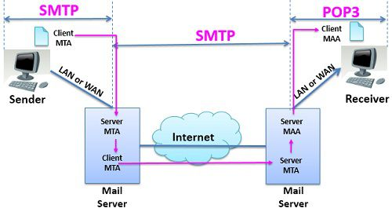
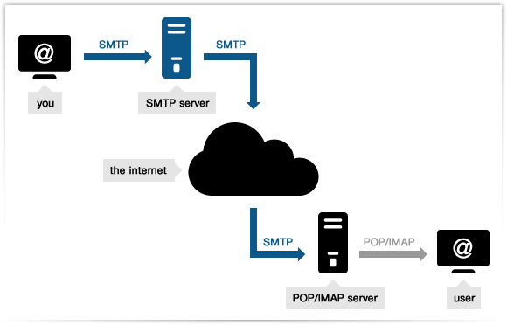
Overview : SMTP

Slide 34
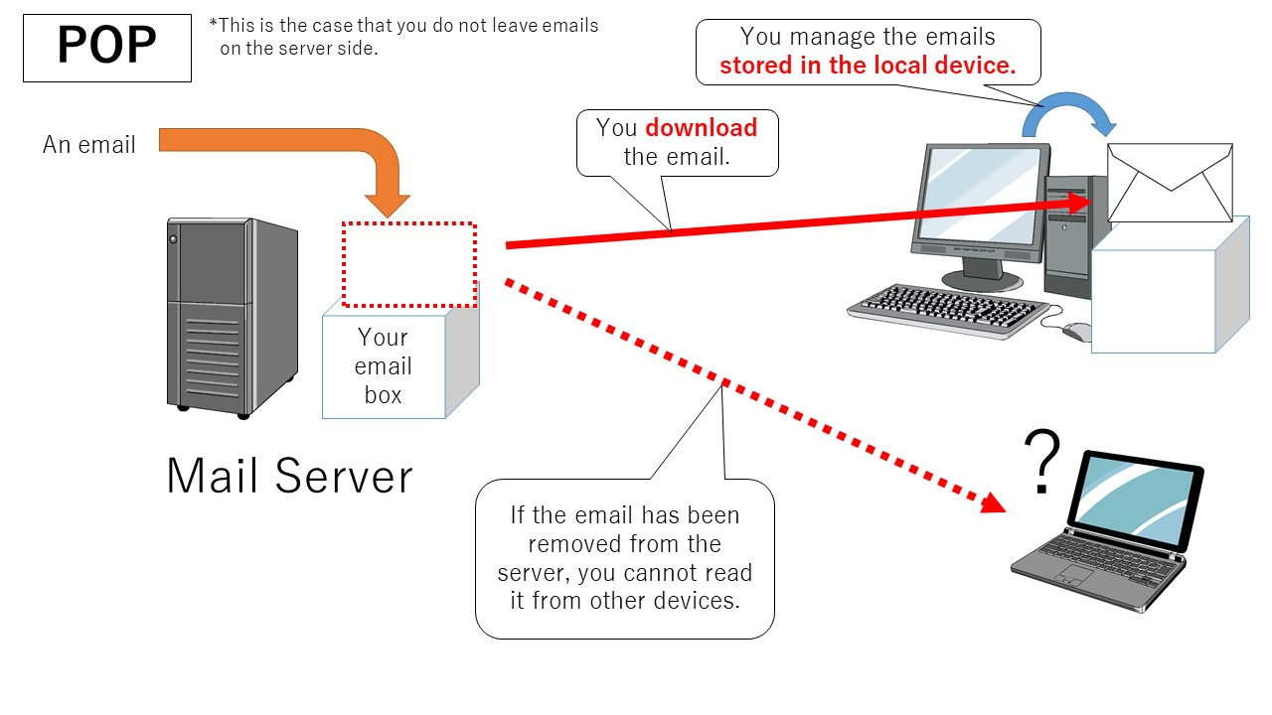
Overview : POP3

Slide 35
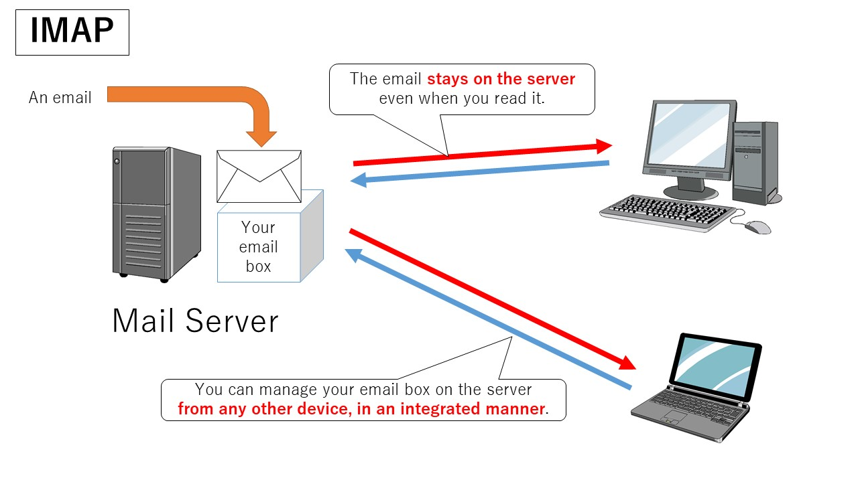
Overview : IMAP

Slide 36
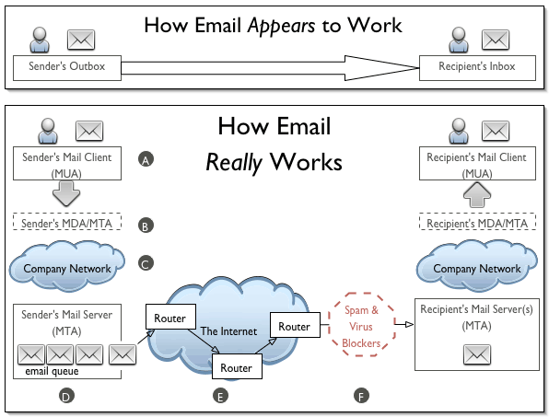
How Email works ?

Slide 37
Topic End

Slide 38

DIRECTORY SERVICES

Slide 39
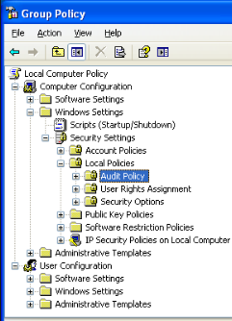
What is directory?
A Directory is a collection of information about objects arranged in some order that gives details about each object.

Slide 40
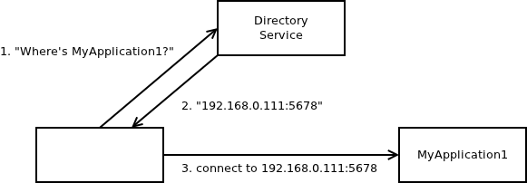
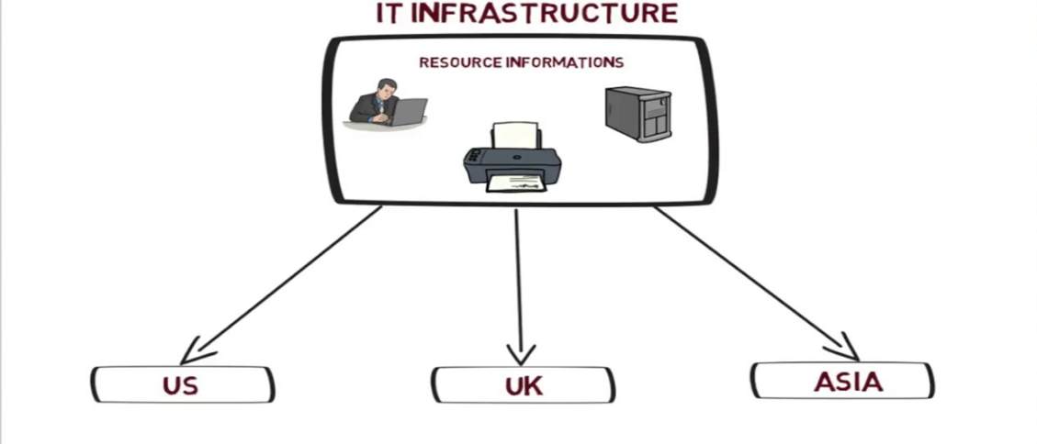
What is Directory services?
Directory services are software systems that store, organize and provide access to the directory information in order to unify network resource.

Slide 41
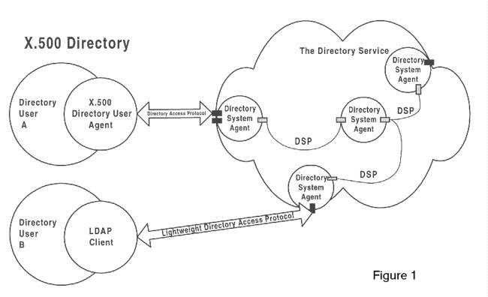
X.500 Directory
X.500 Directory Service is a standard way to develop an electronic directory of people in an organization so that it can be part of a global directory available to anyone in the world with Internet access.

Slide 42

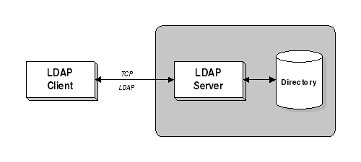
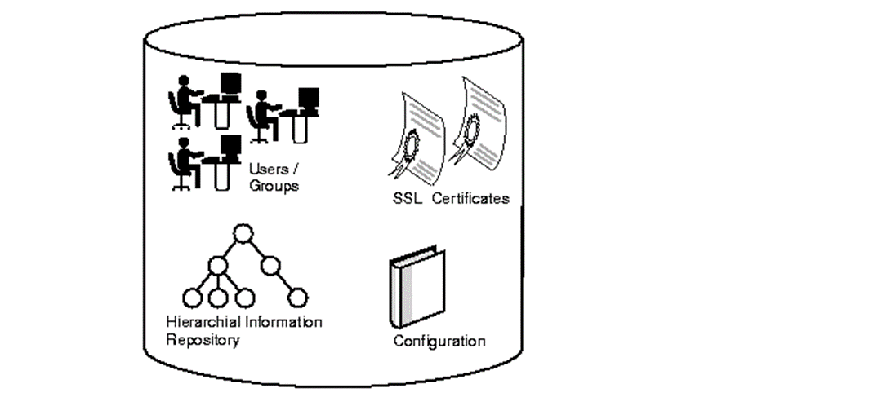
What is LDAP?
Lightweight Directory Access Protocol(LDAP) is a server or client/server protocol used to access and manage directory information.
In order to commence LDAP session, a client needs to connect to the LDAP server, which is set by default to TCP port 389 or UDP port 389

Slide 43
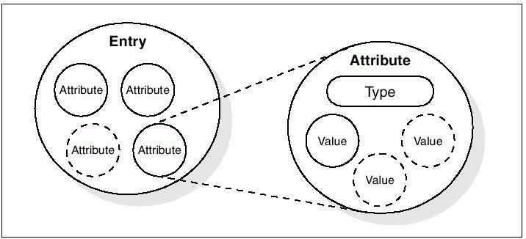
LDAP Information Storage:
Attributes hold the data for an entry.
Each attribute has an attribute type.

Slide 44
Simplifies X.500 functional modes.
Allows use of multiple directories.
Relieves burden of client.
Open source with flexible architecture
Advantages
&
Disadvantages
Updates and patches aren’t released on a regular basis.
Require additional protection such as SSL connection to LDAP server.

Slide 45
Topic End

Slide 46
PROXY
SERVICES

Slide 47

What is Proxy ?
A Proxy server is a dedicated computer or a software system running on a computer that acts as an intermediary between an endpoint device.
To the user, the proxy server is invisible, all Internet requests and returned responses appear to be directly with the addressed Internet server.
FORMAL MEANING :
The authority to represent someone else, especially in voting and COLLEGE LECTURES.

Slide 48
Why Proxy Server
To share Internet connection on a LAN.
To speed up Internet surfing.
To hide the IP address of the client computer.
To bypass security restrictions and filters.
To scan outbound content.
To stream internal content to Internet users.

Slide 49

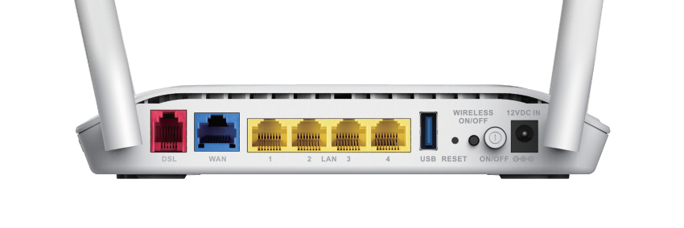
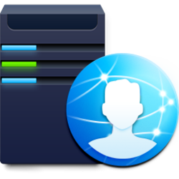

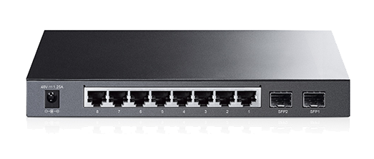



Modem
192.168.1.1
Airtel ISP
192.168.1.10
G : 192.168.1.1
How Proxy
Works ?
192.168.1.11
G : 192.168.1.1
192.168.1.12
G : 192.168.1.10
192.168.1.13
G : 192.168.1.10

Slide 50
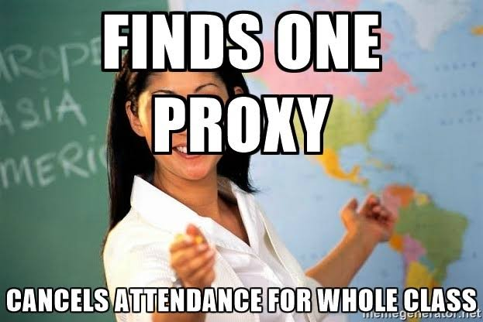
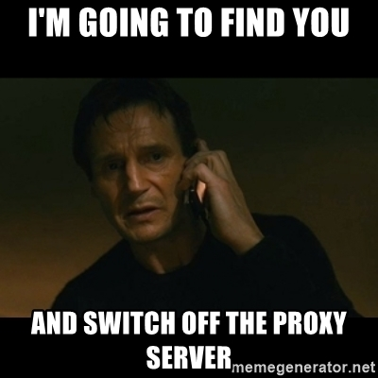
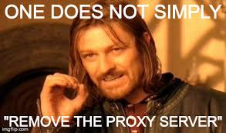
Pros & Cons !!

Slide 51
Topic End

Slide 52
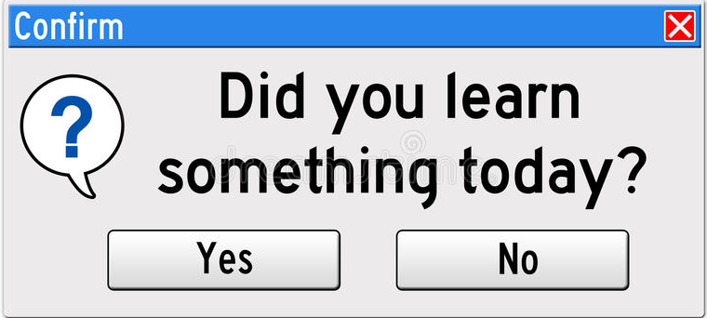
If (answer==“YES”) {
System.out.println (“THANKS”);
}
Else {
System.out.println(“To err is human, to forgive is not company policy”);
}

